Slide 1
Lab 3 : Single Digit Up/Down Counter
Sami Elias, Joseph Popoviciu

Slide 2
Objective
Create an up/down counter that counts from 0 to 9.
The counter must go back to 0 after reaching 9 when counting up
For the down counter, it needs to go back to 9 when it reaches 0
The counter must be displayed on a seven segment display with changing speeds based on a 5-bit select multiplexer

Slide 3
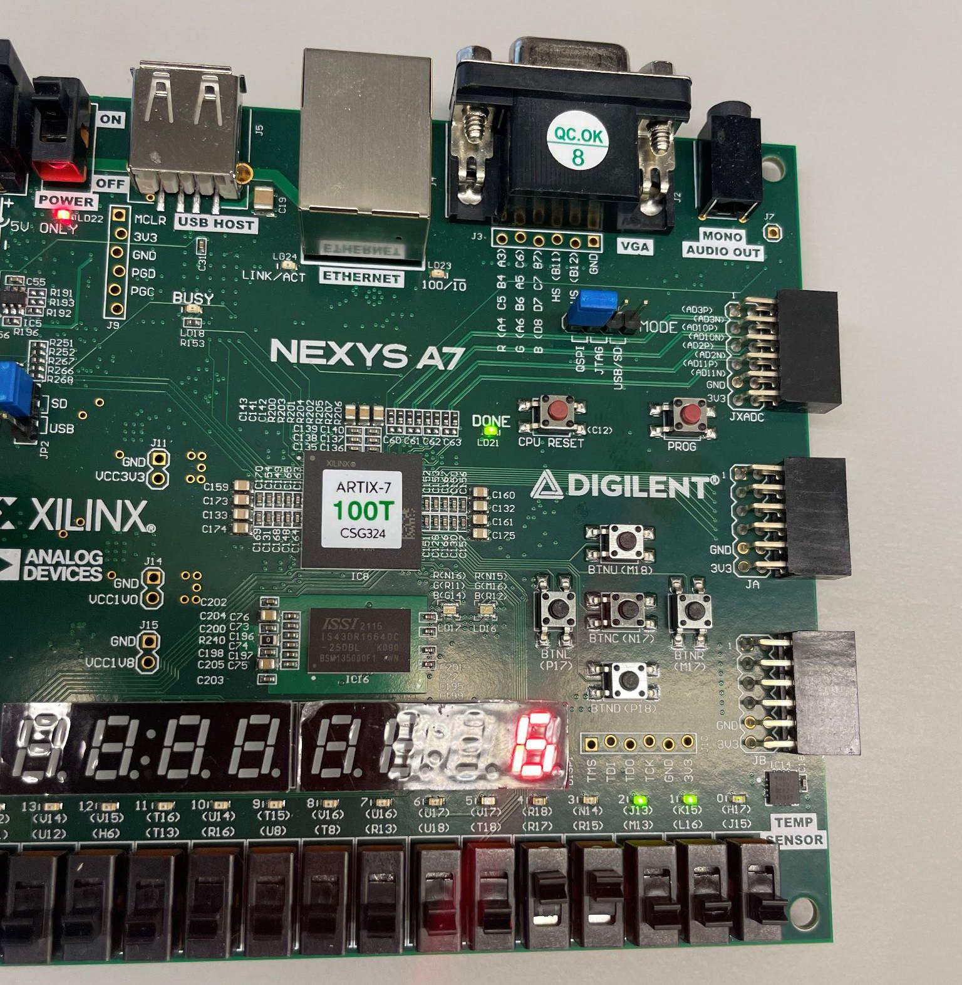
Clock divider
We included a clock divider that slows down the counter based on a 5-bit input.
It is implemented using a
The left is the most significant digit
The right is the least significant digit

Slide 4
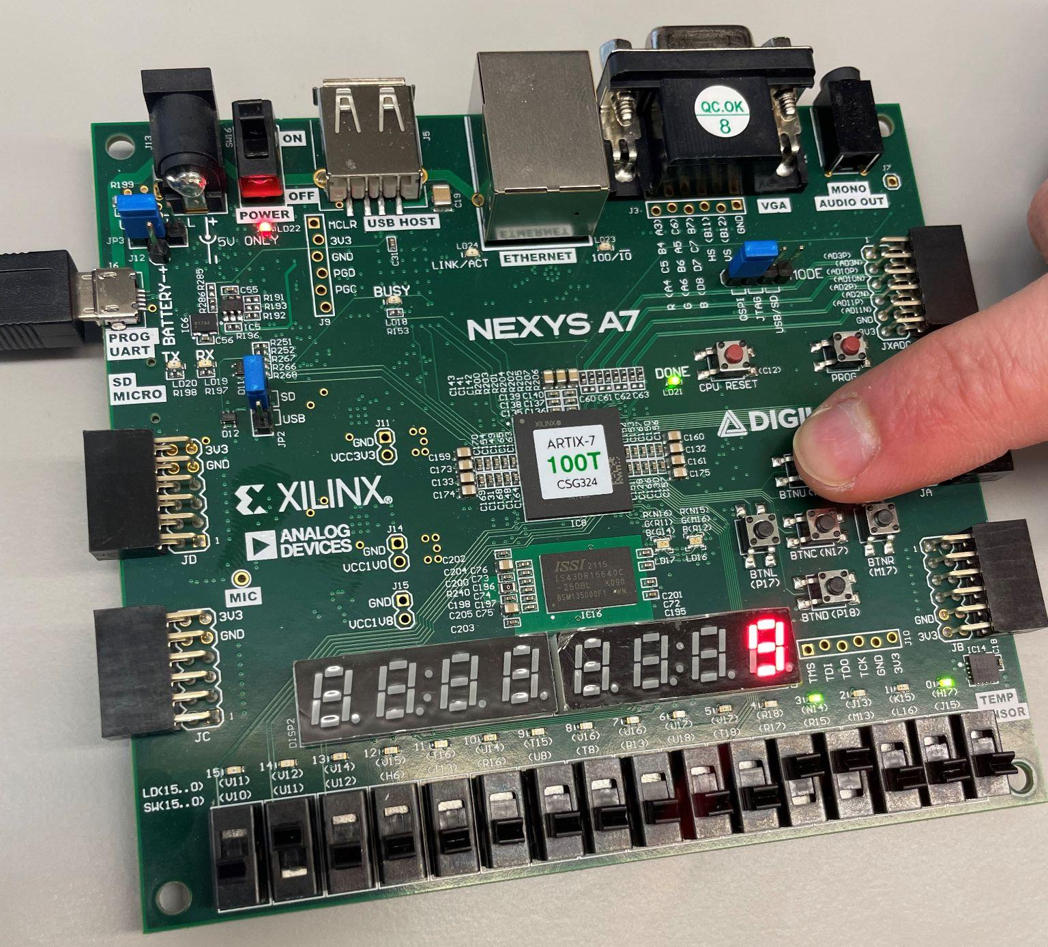
Reset and up/down switch
The switch to the left enables up or down counting.
The reset button will reset the counter to 9 if it is counting up and 0 if it is counting down

Slide 5
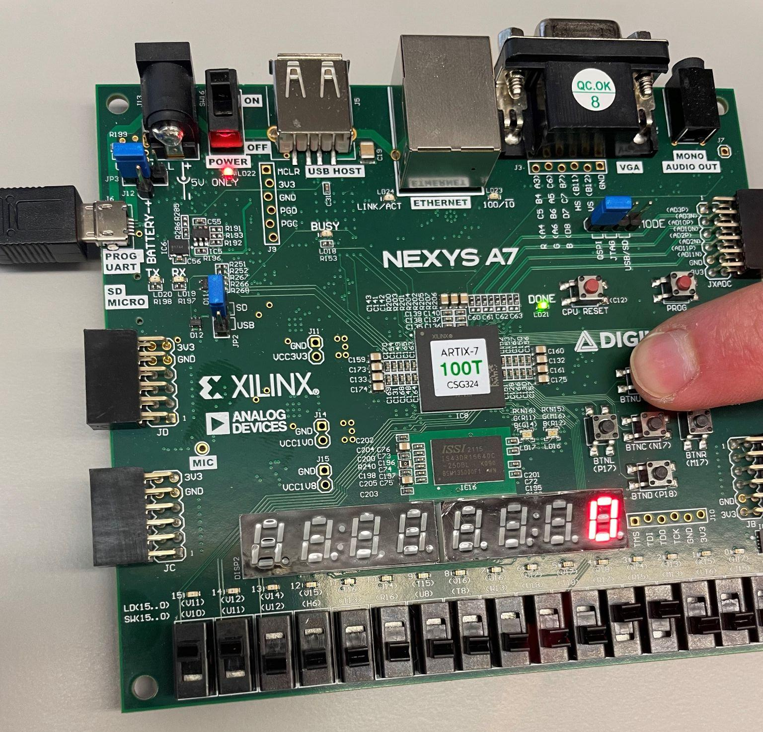
Enable
The enable switch is to the right of
The up/down switch and enables the
Counter. It almost works as a pause
Button.

Slide 6
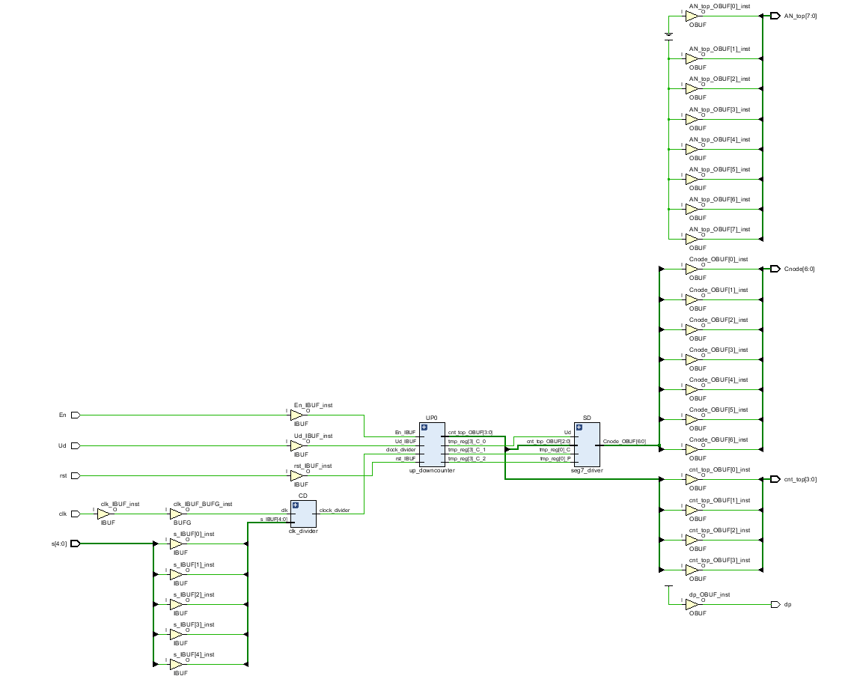
Schematic Implementation

Slide 7
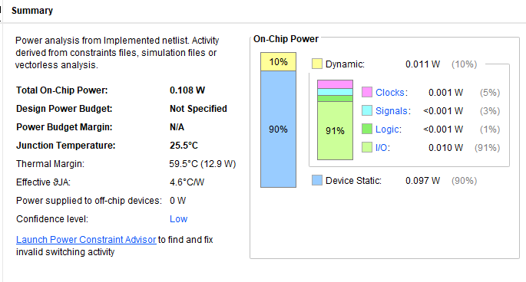
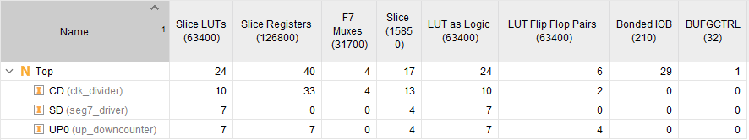
Utilization & Power Summary

